Slide 1
LHC-300 MECHANICAL
LIGHT ASSEMBLY INSTRUCTIONS
OpenAg, MIT Media Lab
By Eugene Zeleny
July 12th, 2019

Slide 2
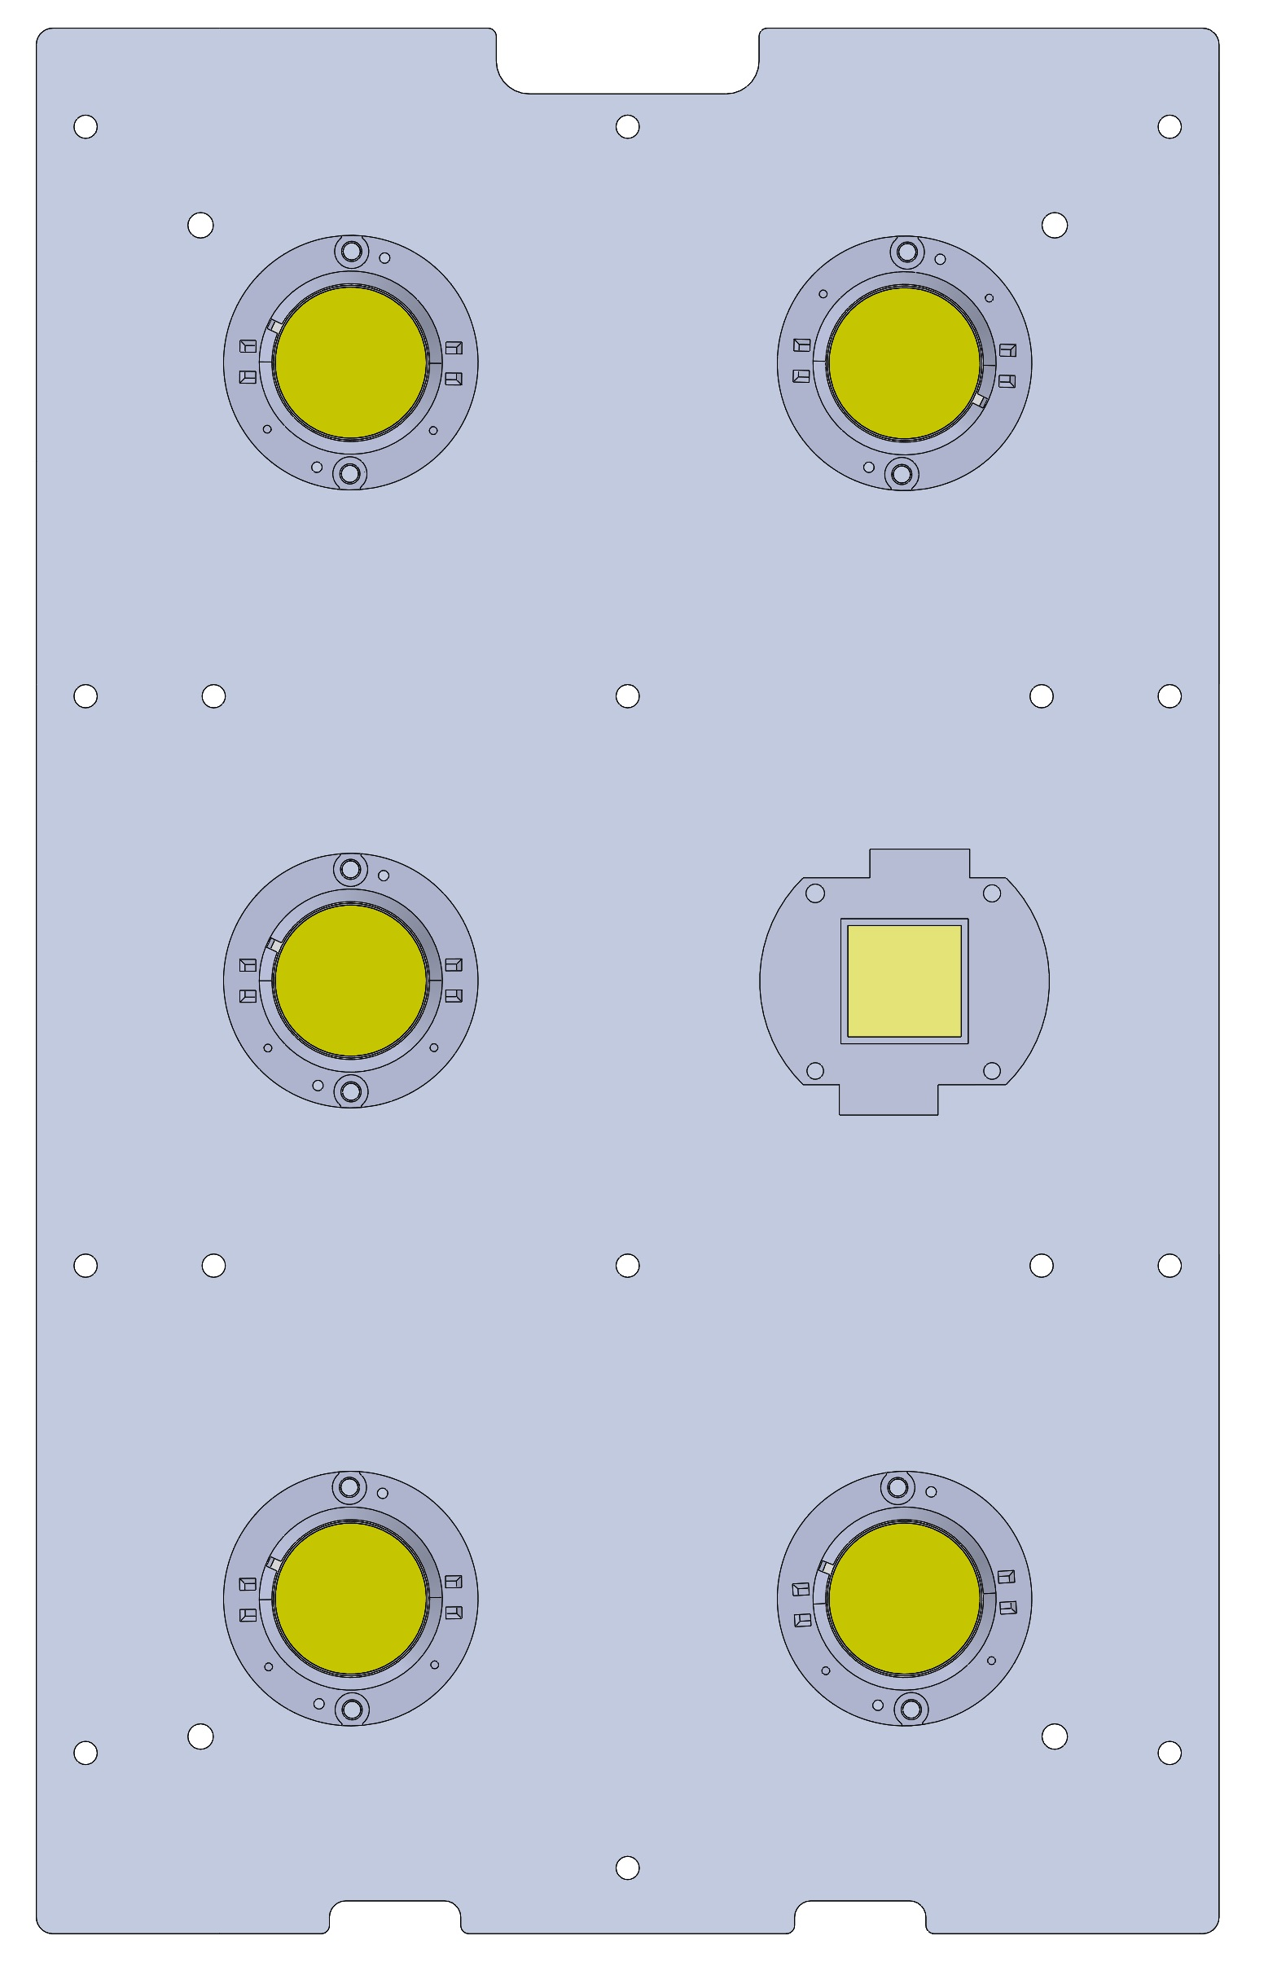
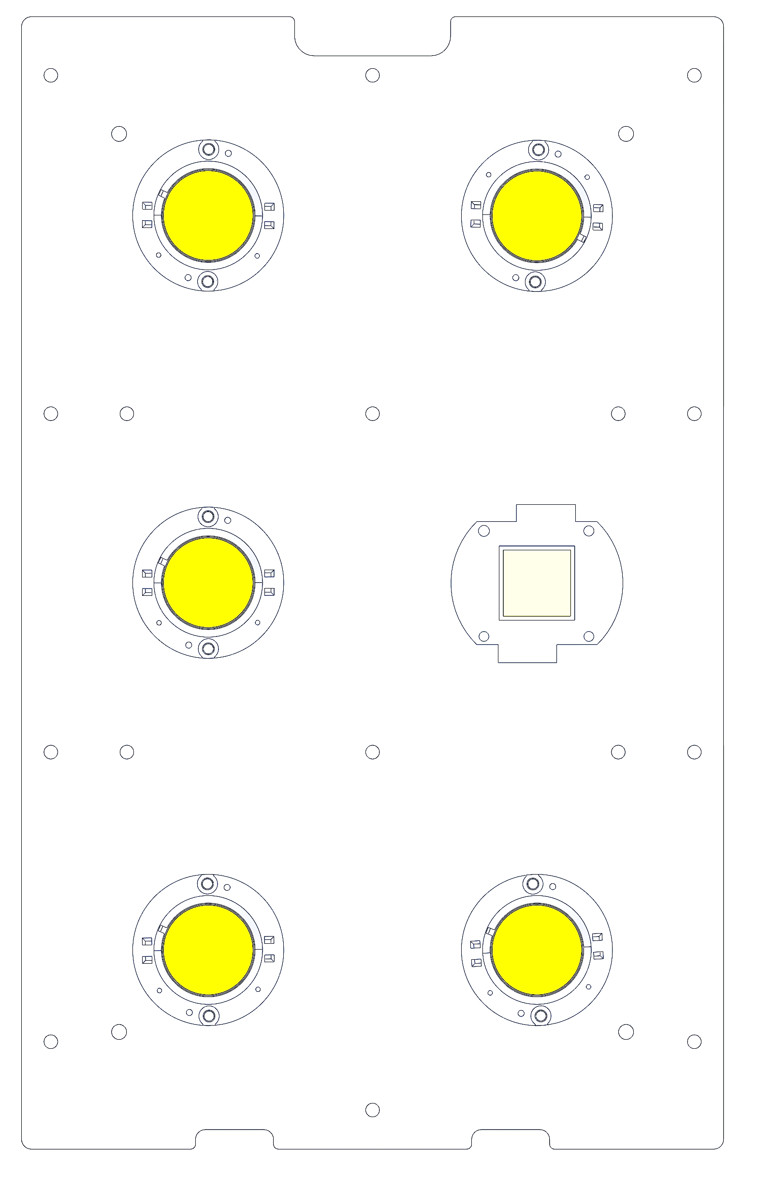
WIRES OUT
YELLOW
ORANGE
ORANGE FOR 40 UNITS
RED FOR 8 UNITS
YELLOW
ORANGE
YELLOW
Attach the LEDs in place on the aluminum plate using the acrylic LED alignment fixture. Ensure the LED orientation matches the instructions
Attach wires to LEDs, tape them down to aluminum plate so that the wires come out the “WIRES OUT” end of the plate

Slide 3
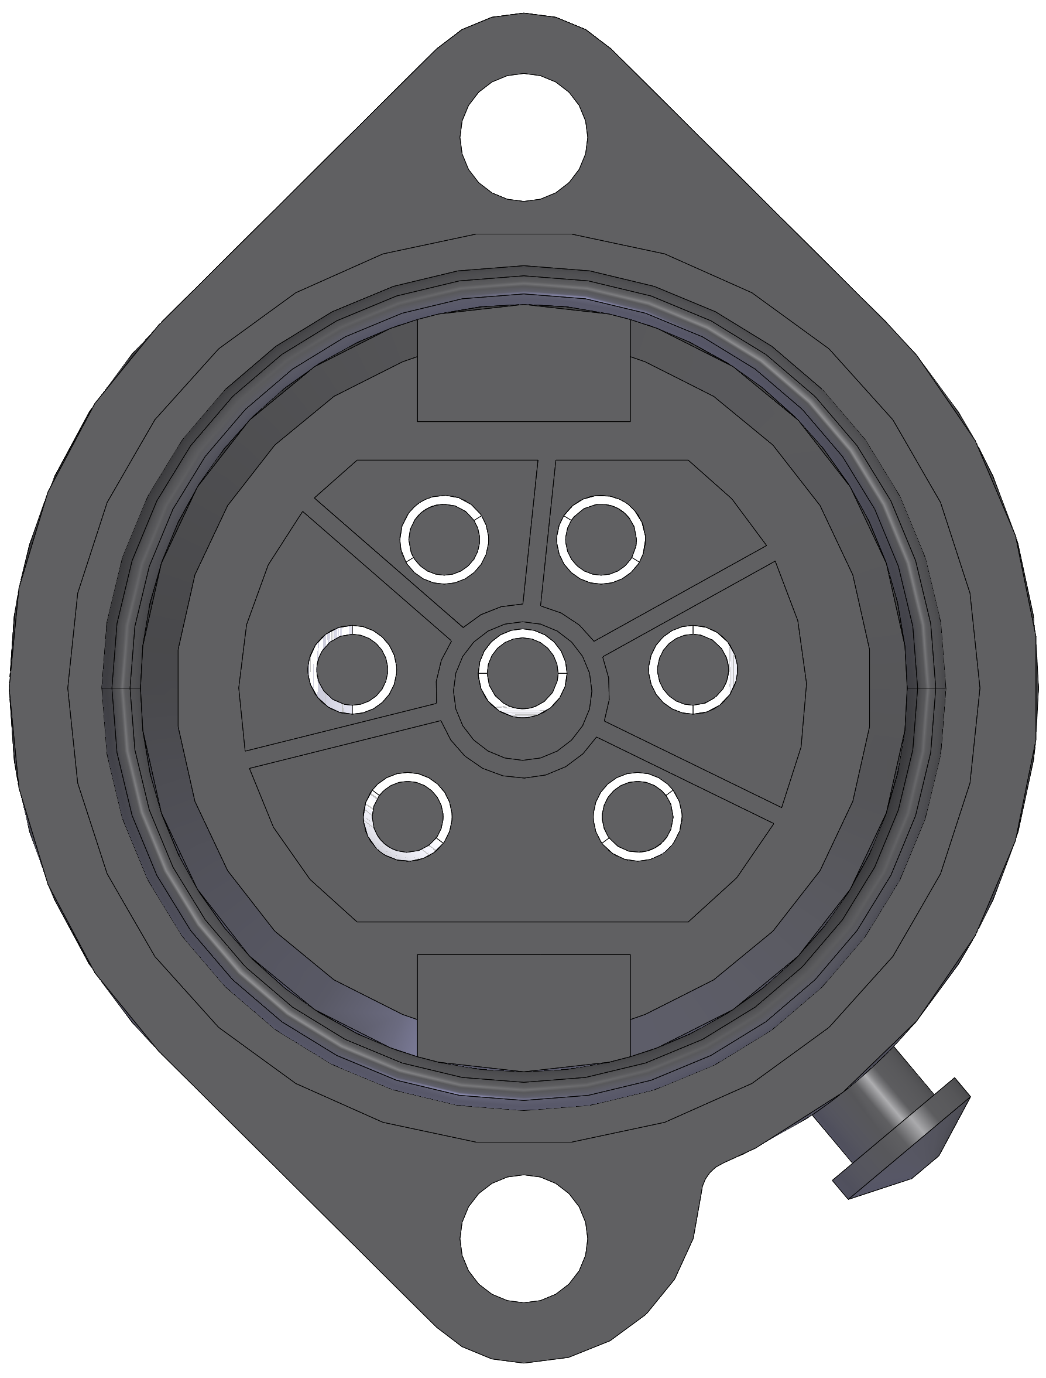
Poles 4/5
4
3
2
5
6
1
Poles 1/2
Poles 3/6
Wire the Electrical Connectors as shown, with 18 AWG wires soldered directly into the connector
Poles 4/5 go to light WARM/ORANGE light
Poles 1/2 go to COOL/YELLOW light
Poles 3/6 go to RED light

Slide 4
WIRES OUT
YELLOW
ORANGE
YELLOW
ORANGE
Poles 1/2
YELLOW
Poles 4/5
ORANGE
For the 40 Yellow/Orange Light Units, use the indicated wiring diagram
Poles 4/5 go to light WARM/ORANGE light
Poles 1/2 go to COOL/YELLOW light

Slide 5
WIRES OUT
YELLOW
ORANGE
Poles 3/6
YELLOW
Poles 1/2
YELLOW
Poles 4/5
ORANGE
For the 8 Yellow/Orange/Red Light Units, use the indicated wiring diagram
Poles 4/5 go to light WARM/ORANGE light
Poles 1/2 go to COOL/YELLOW light
Poles 3/6 go to RED light

Slide 6
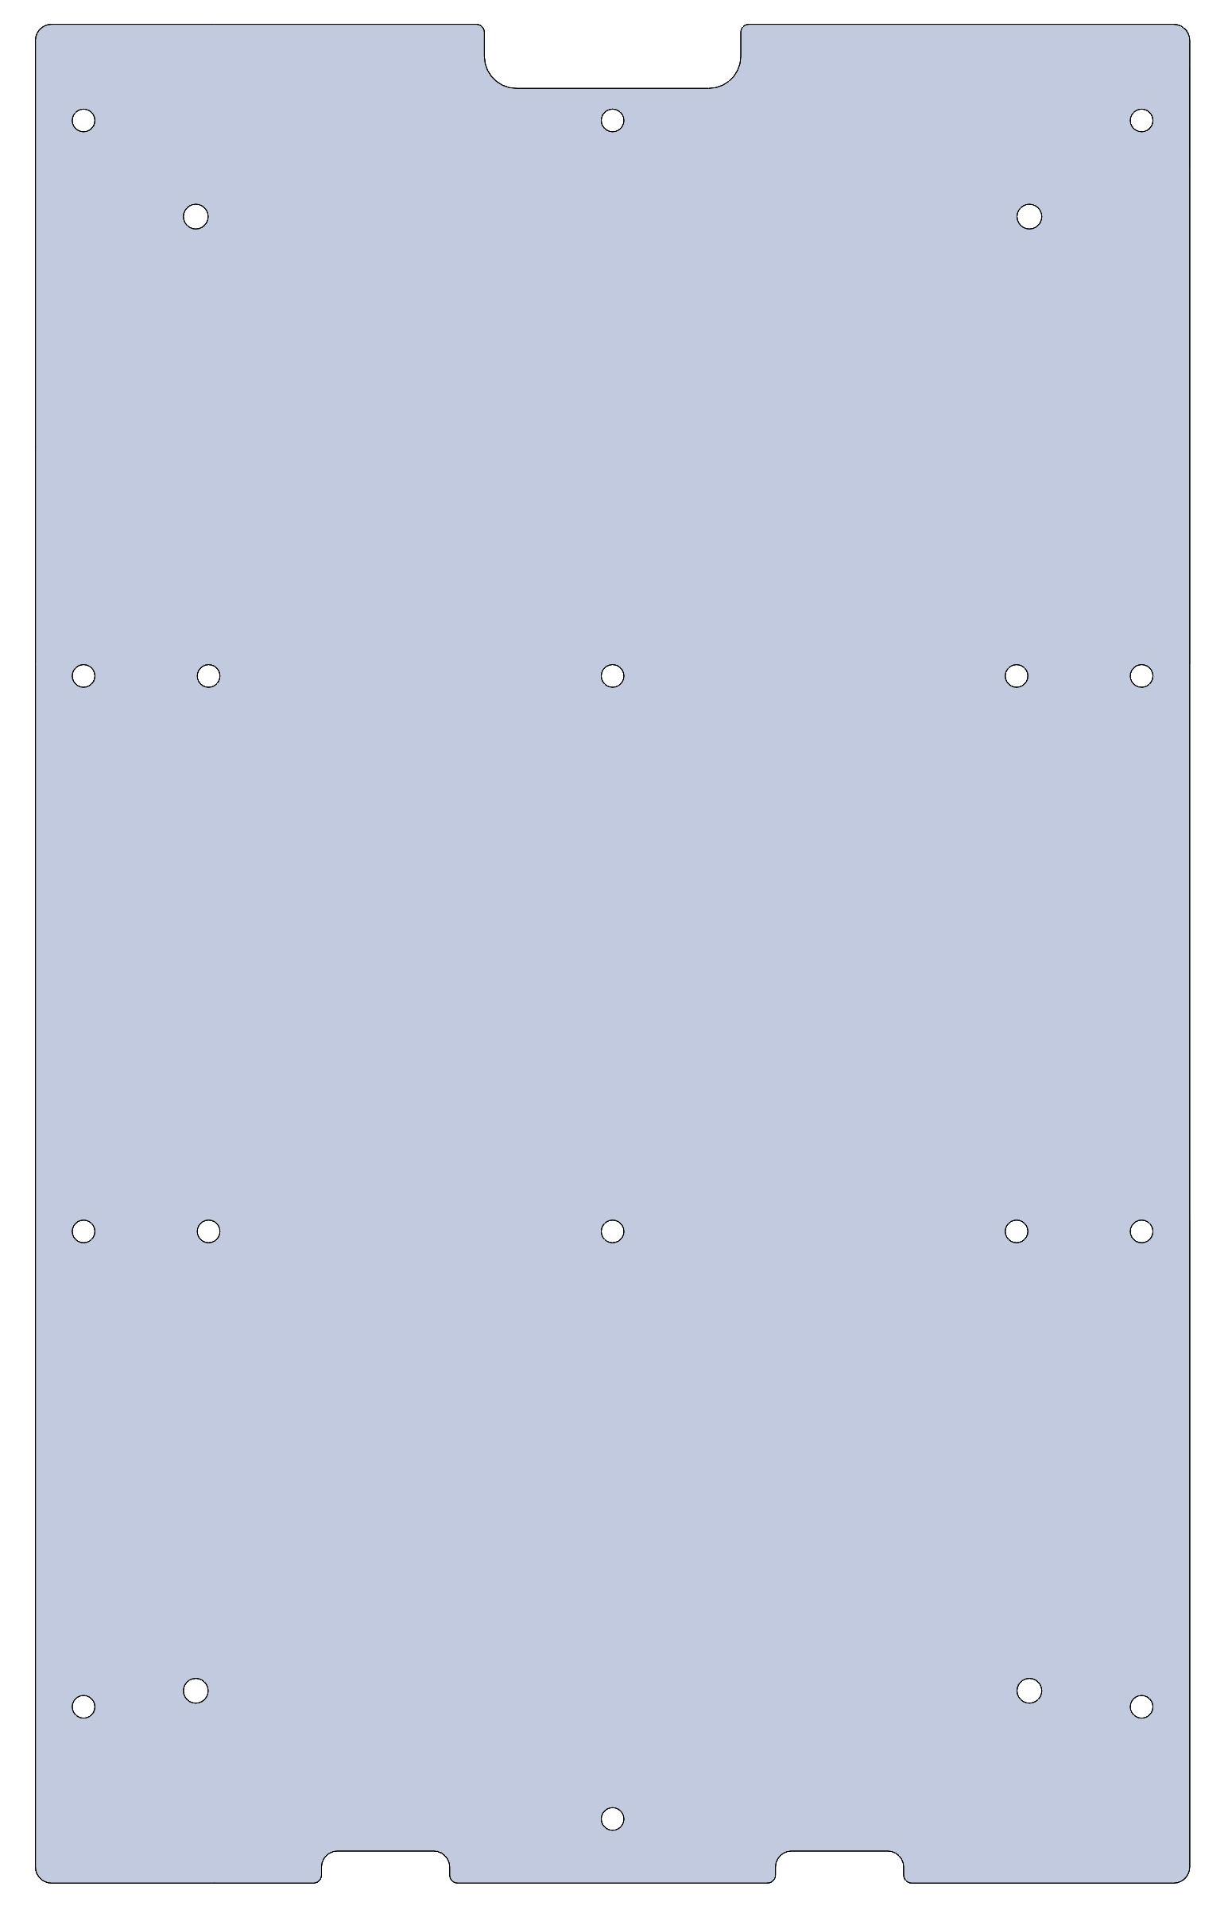
SERIAL #
Flip the aluminum plate over and place a serial number sticker on the bottom right of the plate, for reference.
STOP ASSEMBLY HERE: TEST THE LIGHT PANEL BY GIVING IT POWER TO ENSURE THE LEDS ARE WIRED CORRECTLY

Slide 7
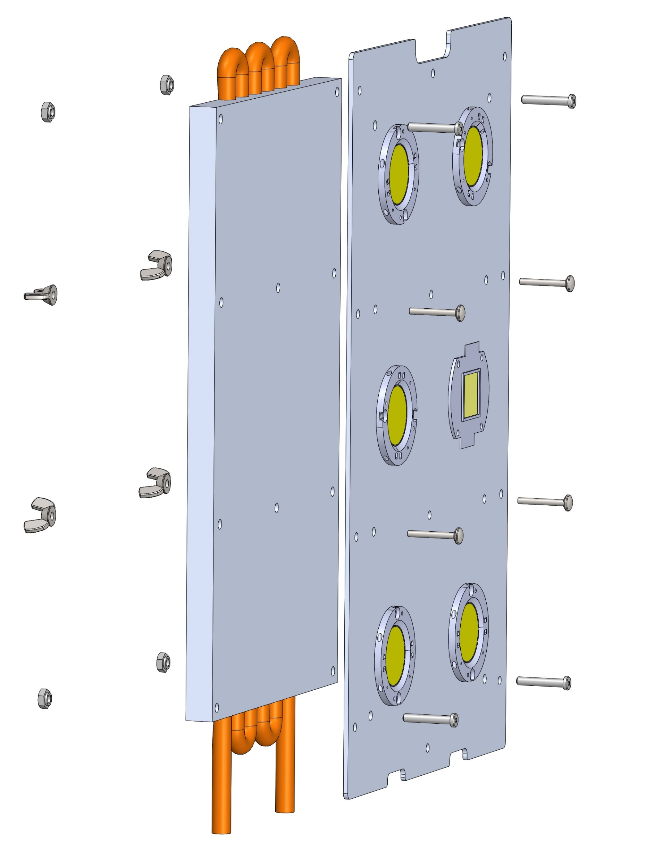
8-32 LOCK NUT #96278A009
8-32 LOW PROF. HEAD 1” LONG #90665A115
8-32 WING NUT #90866A009
8-32 PAN HEAD PHILLIPS 1” LONG #95345A554
Thin, even layer of thermal grease
over entire indicated surface
Apply thermal grease to mating surface of heat sink
Attach heat sink to aluminum plate with indicated hardware

Slide 8
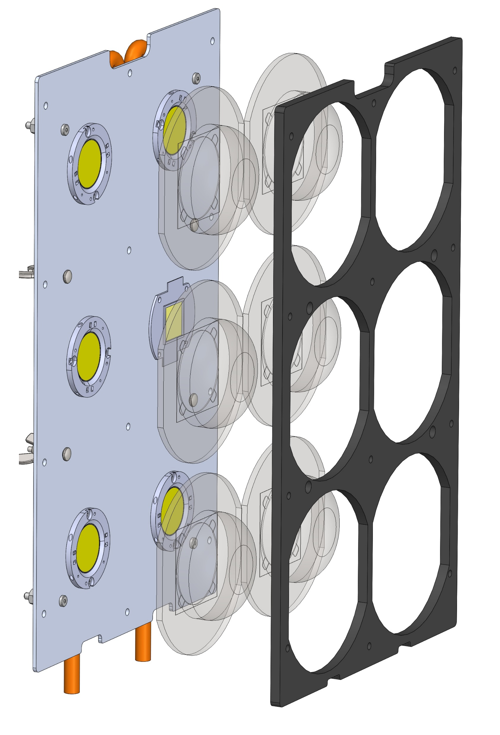
Position clear optics over each LED and position foam gasket over the optics, using the notched indicators for alignment

Slide 9
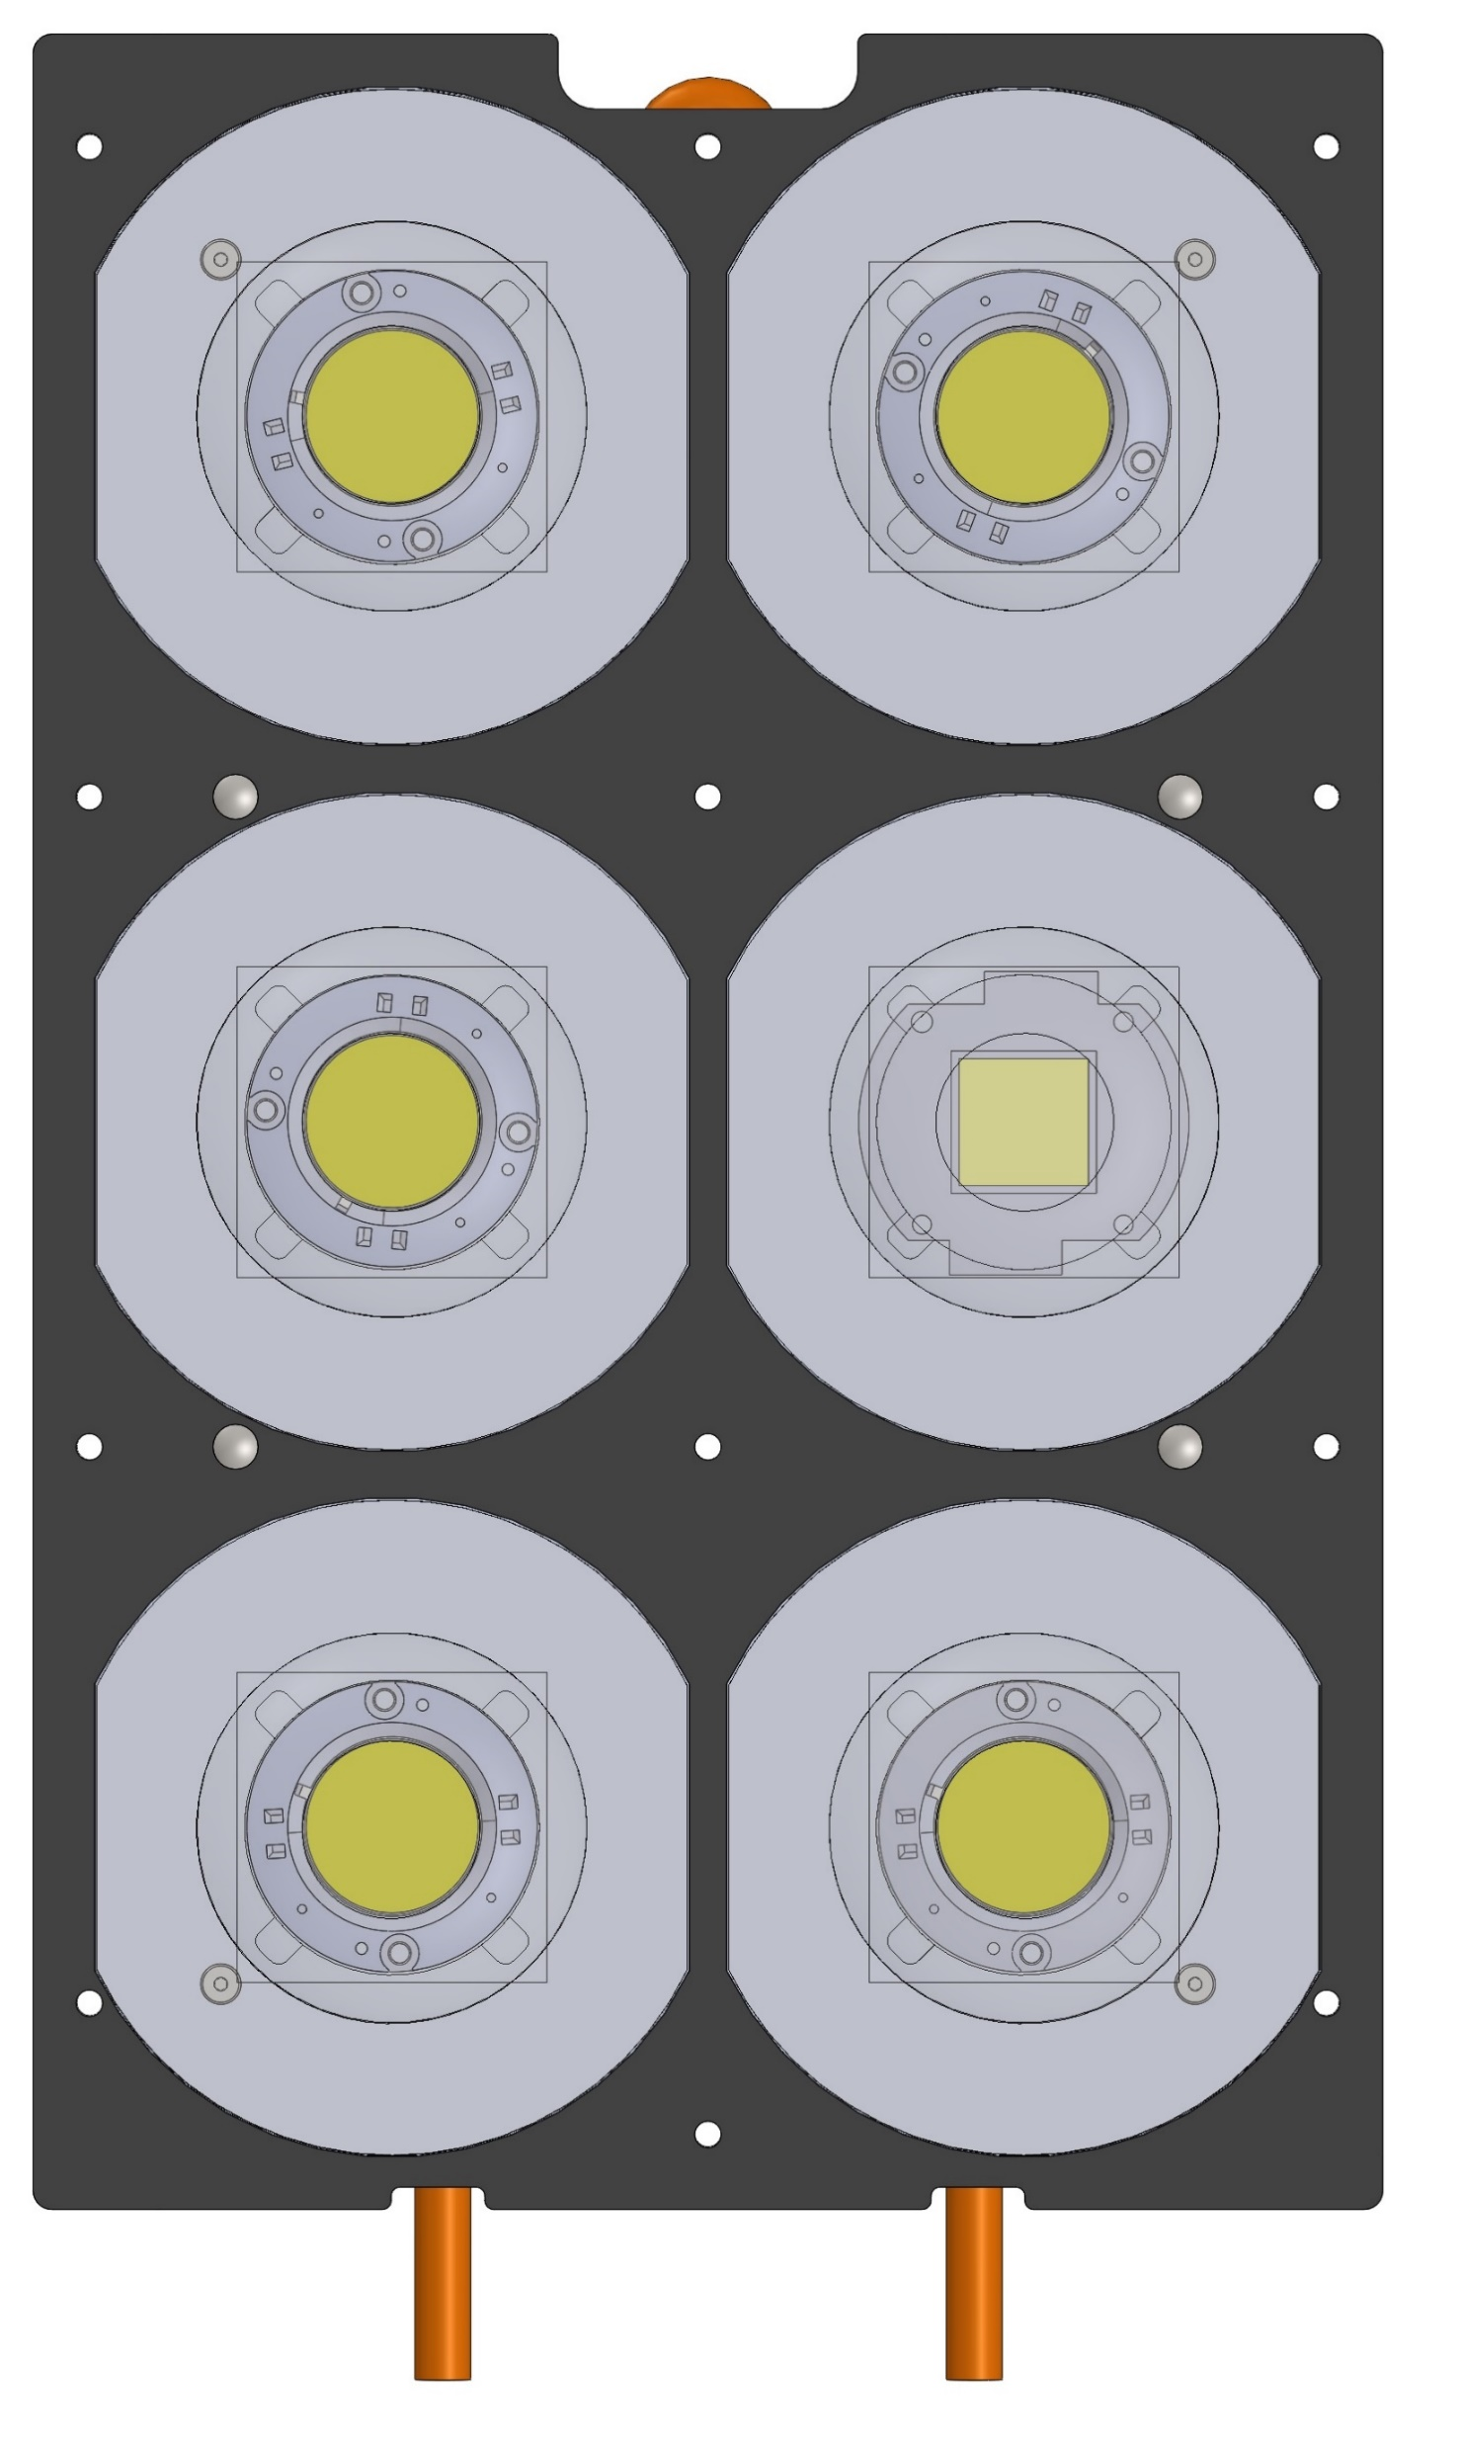
This is what the assembly should look like at this point

Slide 10
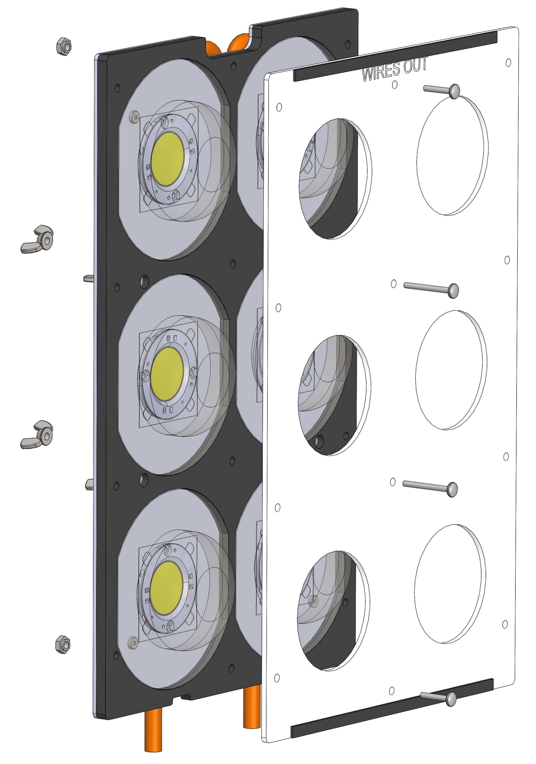
8-32 LOCK NUT #96278A009
8-32 PAN
HEAD PHILLIPS
¾” LONG #95345A548
8-32 PAN HEAD PHILLIPS 1.25” LONG #95345A555
8-32 WING NUT #90866A009
¼” WIDE, 1/16” THICK FOAM,
7.25” LONG #8694K111
Attach 1/16th foam strip as shown, centered on plastic cover plate
Attach plastic cover plate to assembly with indicated hardware

Slide 11
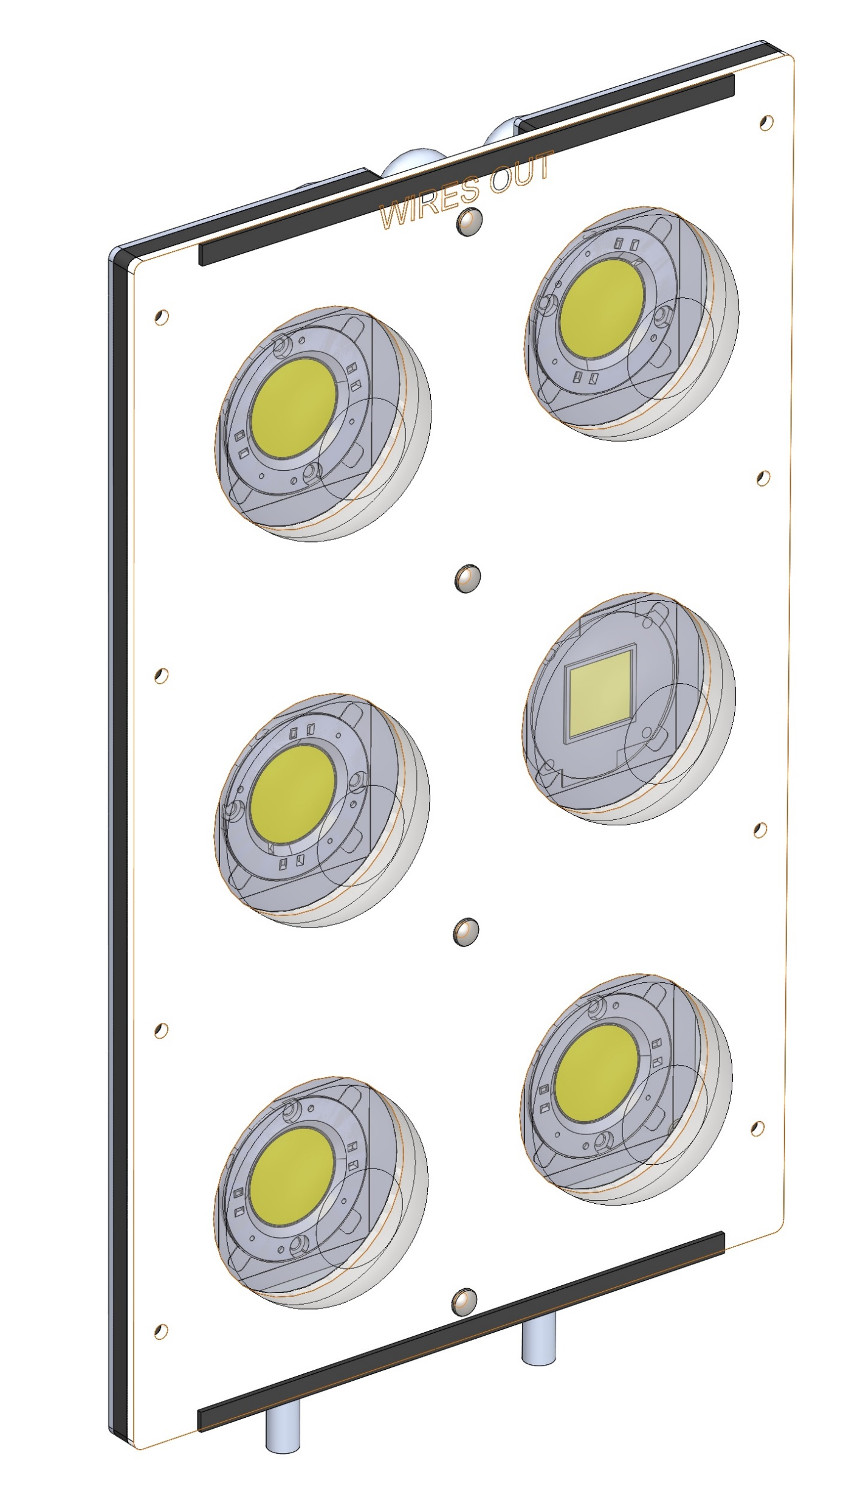
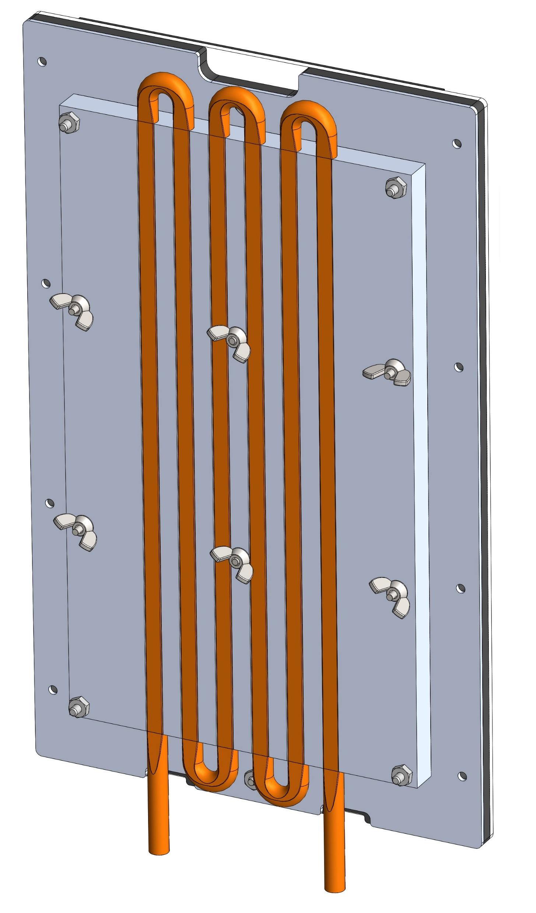
SERIAL #
SERIAL #
Place corresponding Serial Number Sticker on front ABS plate in top left corner as shown.

Slide 12
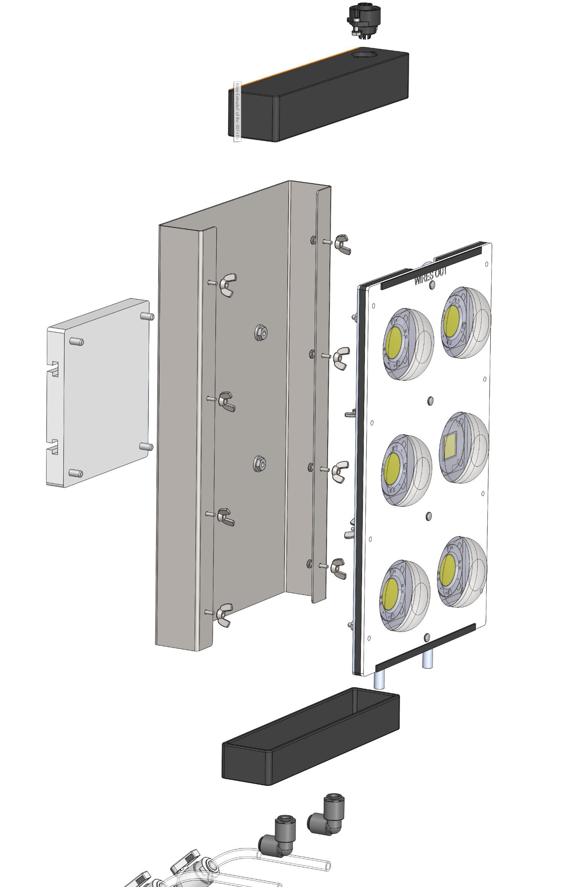
¼-20 FLANGED LOCK NUT #93776A421
¼-20 BOLT #92196A541
Attach the Mounting Arm Adapter Plate to the sheet metal enclosure with the indicated hardware (x4).

Slide 13
8-32 PAN
HEAD PHILLIPS
¾” LONG #95345A548
8-32 WING NUT #90866A009
Attach the light assembly “sandwich” to the sheet metal enclosure with the indicated hardware

Slide 14
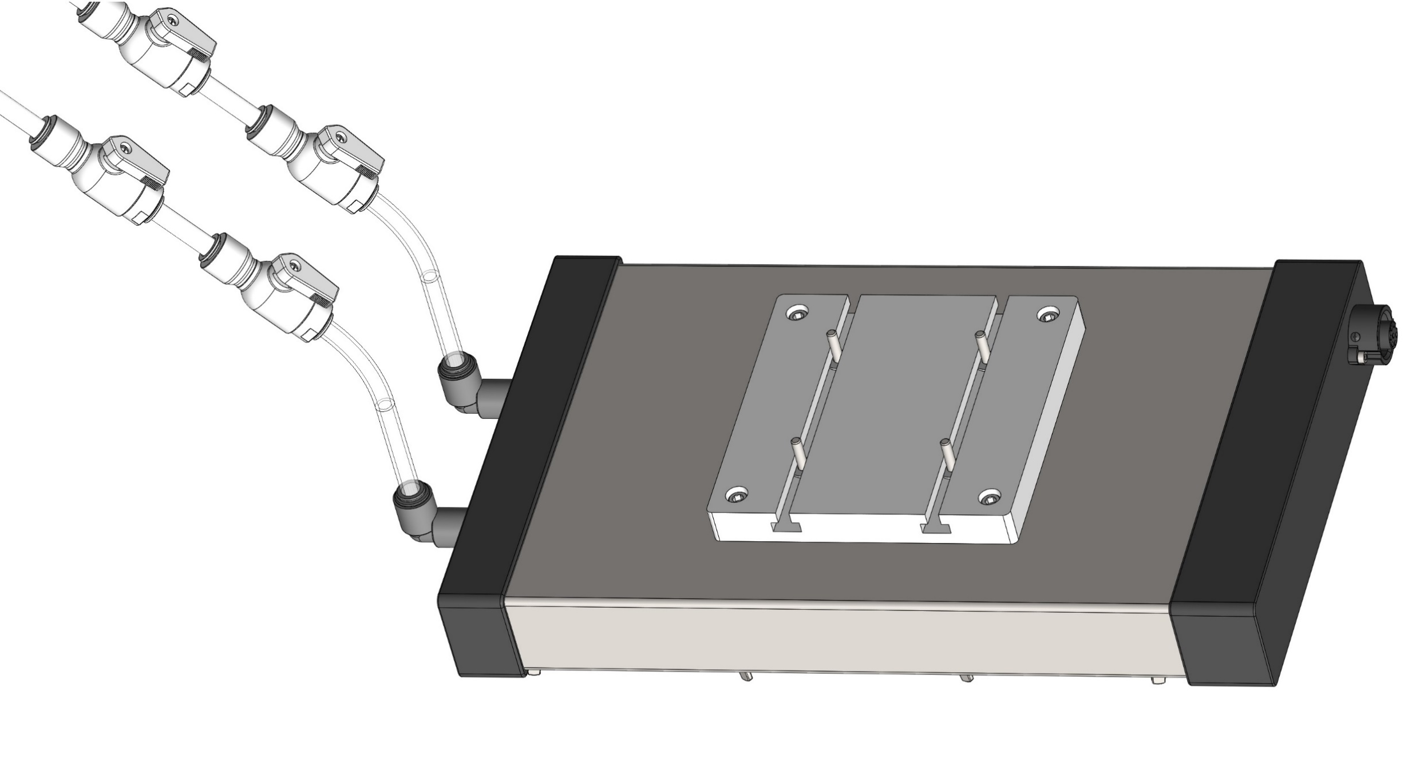
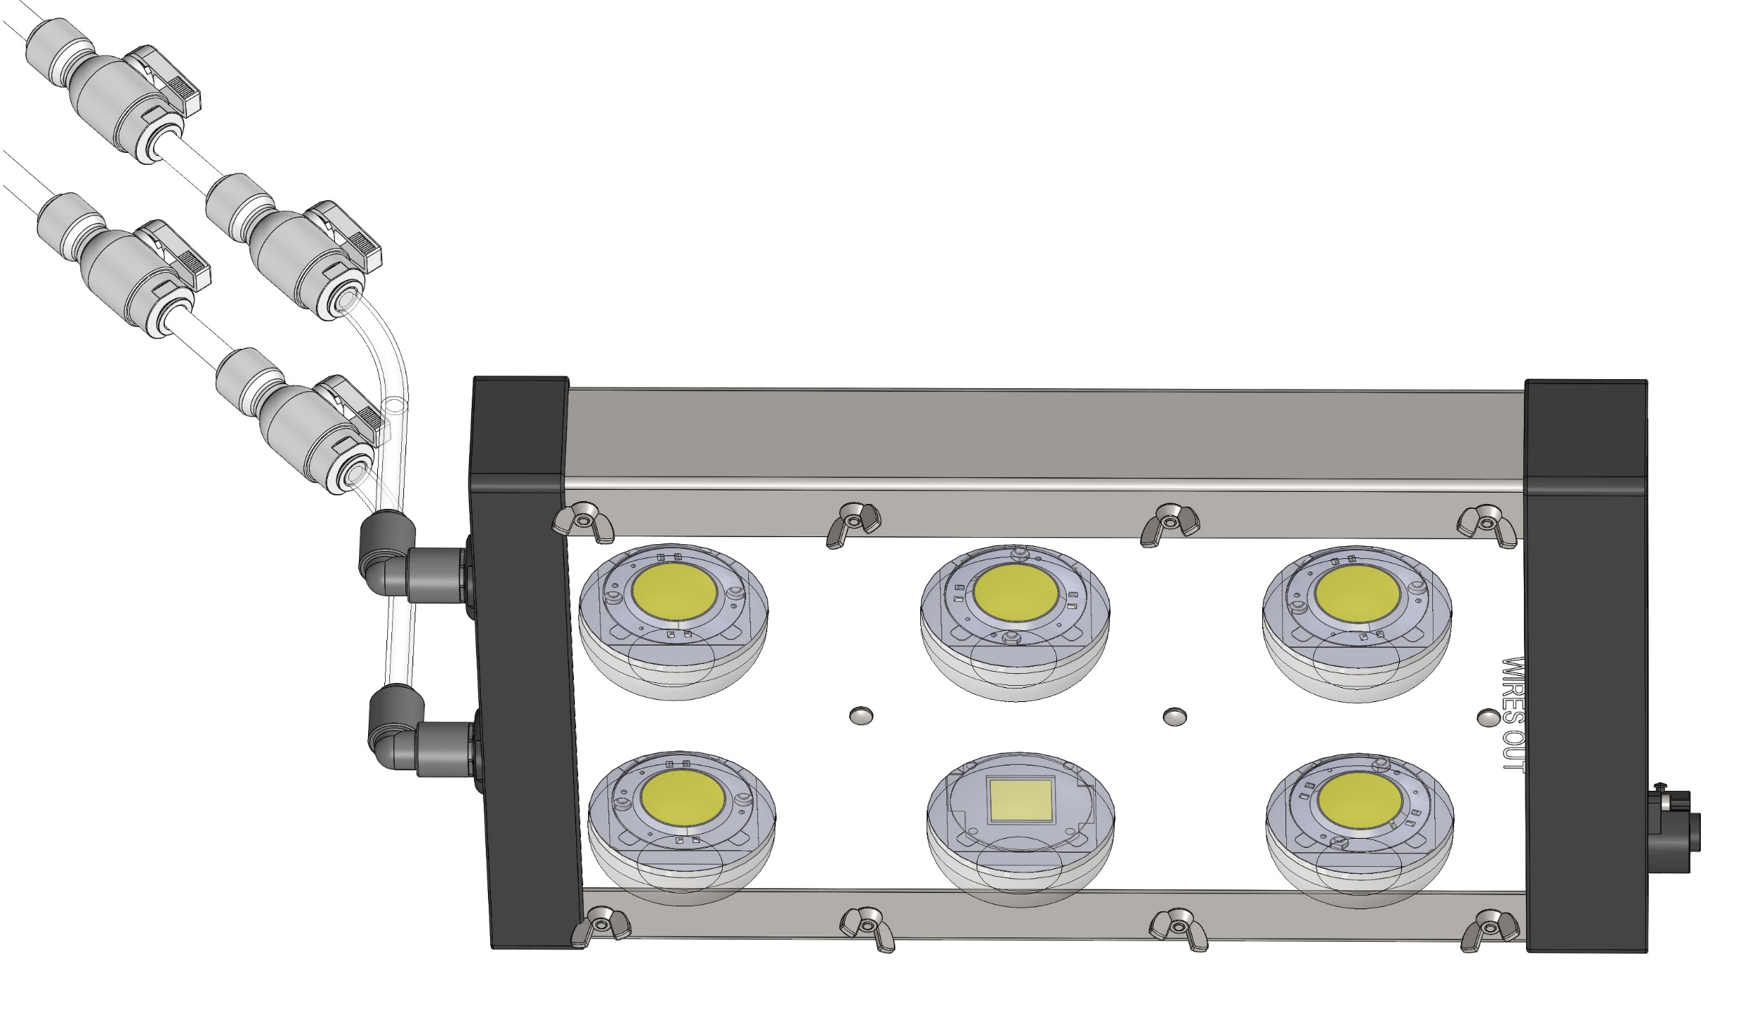
6-32 Bolt and
Lock Nut
Slip the top and bottom end-caps onto the assembly.
Attach the top end-cap to the Electrical Connector with the indicated hardware
Attach the fluidic connectors to the brass tubing, and fluidic valves to the pre-cut tubing, as shown.

